Slide 1

Project 1: Andrew Middleton Scott Kutlick

Slide 2

AGENDA
Project Proposal
Data Analysis
decision
FINAL Comments & TAKEAWAYS

Slide 3

Major Motion Picture Investment

Slide 4
Project Proposal
Major Motion Picture Investment

Slide 5

Project Proposal
Mutual interest in movies and film as entertainment, as well as a future career path
Top 10 Highest Grossing Films (1975-2018) (kaggle.com)

Slide 6
Data Analysis
Major Motion Picture Investment

Slide 7
What Kind of Movie to make and which Studio to partner with in order make the most money?
Film Attributes:
What MPAA rating hits the “sweet spot” for attracting the largest audiences?
Does an animated or live-action movie generate more worldwide gross income?
What genre and / or sub-genres should we target?
Does the length of a movie matter to the overall gross income?
Studio / Distributor Attributes:
Do certain production companies focus primarily on specific genres and/or MPAA ratings?
On average, which studios tend to generate higher gross income at the box office?
Which distributors tend to put out higher quality films?
Is there correlation between the IMDb rating of a movie and the gross income?

Slide 8
Decision
Major Motion Picture Investment

Slide 9
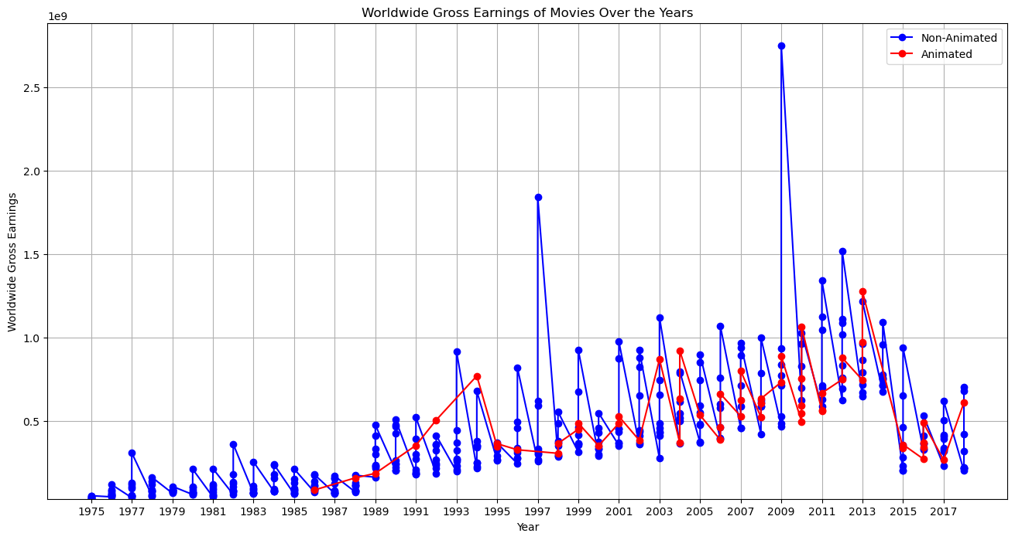
Gross Earnings: Animated vs. Non-AnimateD Films

Slide 10
FINAL Comments & TAKEAWAYS
Major Motion Picture Investment

Slide 11
Additional Dataset Considerations
The dataset we used focuses on Top 10 Worldwide Gross, per year
By focusing on just the “winners” we might be introducing

Slide 12
FINAL TIPS & TAKEAWAYS
Consistent rehearsal
Strengthen your familiarity
Refine delivery style
Pacing, tone, and emphasis
Timing and transitions
Aim for seamless, professional delivery
Practice audience
Enlist colleagues to listen & provide feedback
Seek feedback
Reflect on performance
Explore new techniques
Set personal goals
Iterate and adapt

Slide 13
NAVIGATING Q&A SESSIONS
Know your material in advance
Anticipate common questions
Rehearse your responses
Maintaining composure during the Q&A session is essential for projecting confidence and authority. Consider the following tips for staying composed:
Stay calm
Actively listen
Pause and reflect
Maintain eye contact

Slide 14
Dynamic delivery
Learn to infuse energy into your delivery to leave a lasting impression
One of the goals of effective communication is to motivate your audience
METRIC | MEASUREMENT | TARGET | ACTUAL
Audience attendance | # of attendees | 150 | 120
Engagement duration | Minutes | 60 | 75
Q&A interaction | # of questions | 10 | 15
Positive feedback | Percentage (%) | 90 | 95
Rate of information retention | Percentage (%) | 80 | 85

Slide 15
SPEAKING ENGAGEMENT METRICS
IMPACT FACTOR | MEASUREMENT | TARGET | ACHIEVED
Audience interaction | Percentage (%) | 85 | 88
Knowledge retention | Percentage (%) | 75 | 80
Post-presentation surveys | Average rating | 4.2 | 4.5
Referral rate | Percentage (%) | 10 | 12
Collaboration opportunities | # of opportunities | 8 | 10

Slide 16

THANK YOU

